Slide 1
Computer Says ‘No’ - Automation, Algorithms, & Artificial Intelligence in Government Decision-Making
Dominique Hogan-Doran SC
The Ethics of Data Science Conference
University of Sydney, 28 March 2019

Slide 2
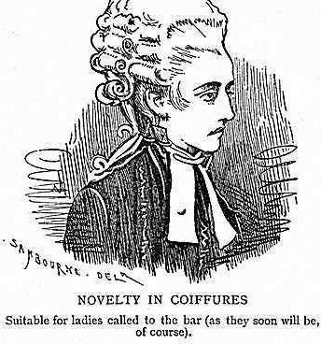
Presenter
Dominique Hogan-Doran SC
Dominique is a Senior Counsel of the Australian Bar.
She is Chair of the Australian Bar Association’s Futures Committee, & an officer of the International Bar Association’s Bar Regulation Committee.
This is a presentation of her paper, Computer says “no”: automation, algorithms, and artificial intelligence in Government decision making, published by the Judicial Commission of New South Wales in The Judicial Review (September 2017).
Web: www.dhdsc.com.au Twitter: @DHoganDoranSC LinkedIn: linkedin.com/in/hogandoransc

Slide 3
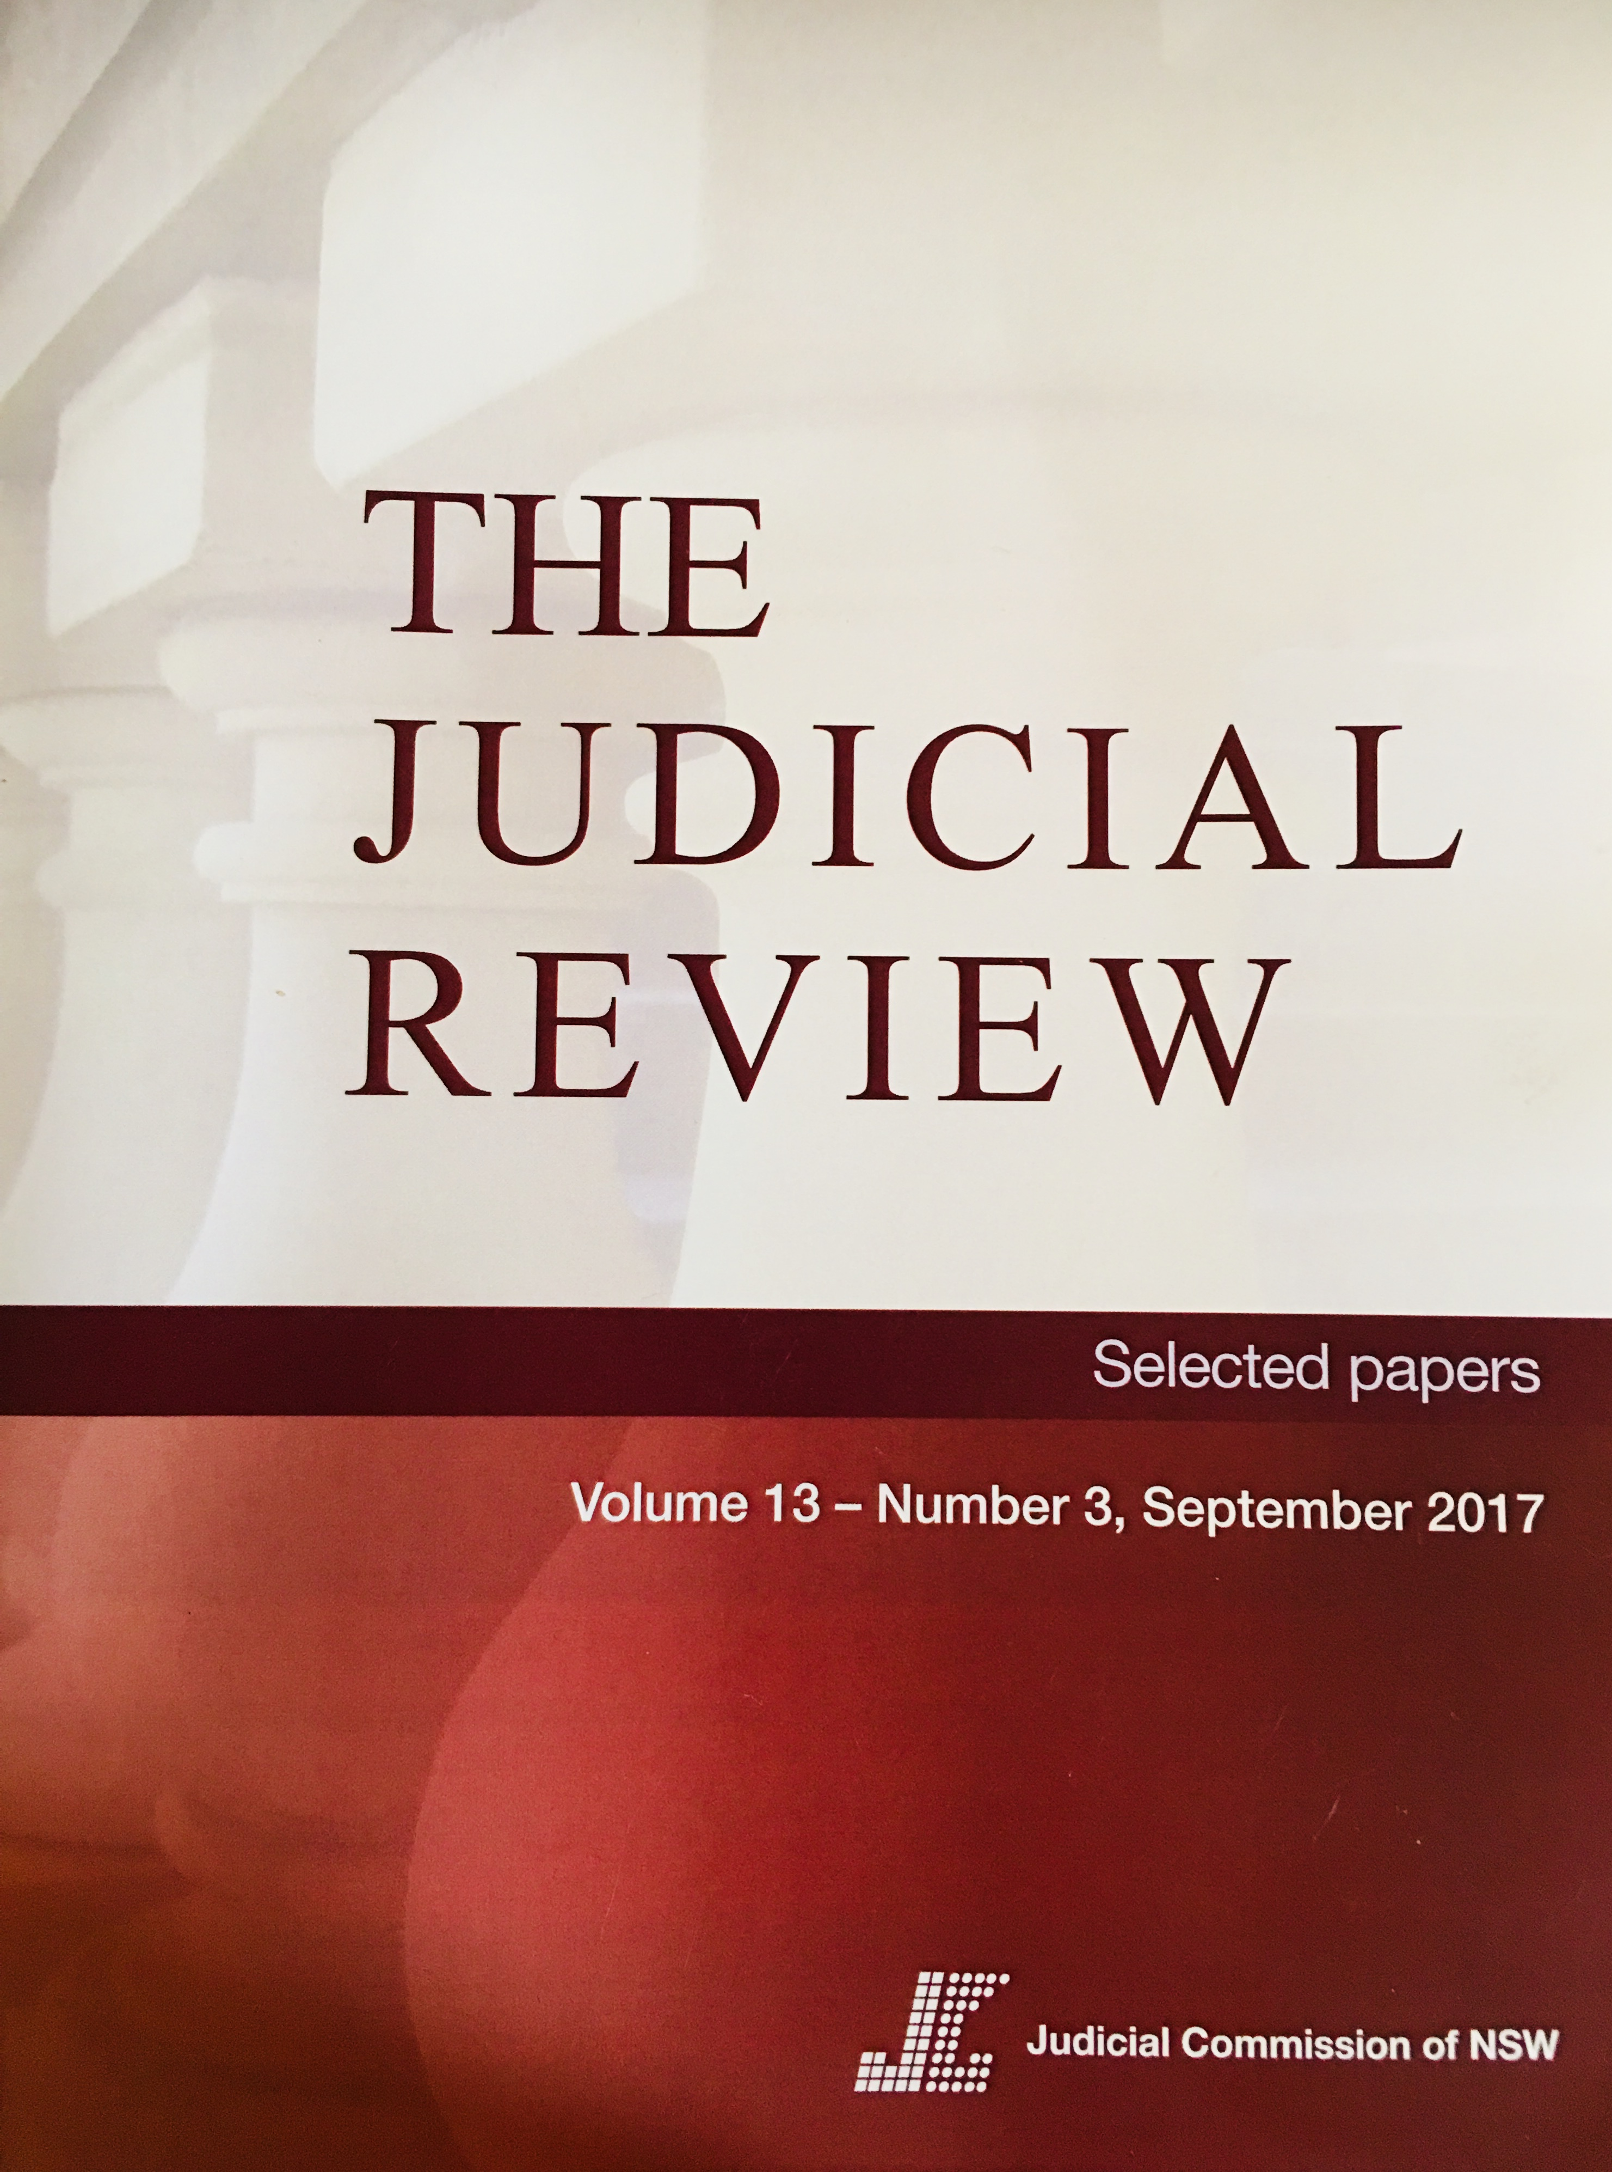
Summary
Many administrative decisions that used to be based on human reflection are made automatically.
Bureaucracy is no longer what it once was.
How will public law’s mandates of transparency, fairness, and accuracy be guaranteed?
Increasing pervasiveness of technology assisted decision-making makes the public law challenge particularly acute.
The full basis for algorithmic & robotic AI decisions is rarely available to affected individuals
We require more governmental transparency, clear & effective regulation, & widespread awareness of dangers & mistakes already occurring.

Slide 4
Why use technology to assist government decision making?
Modern bureaucracy is an ideal candidate for algorithm-based, automated habitus:
“Bureaucracy is an organisational structure that is characterised by many rules, standardised processes, procedures and requirements, number of desks, meticulous division of labour and responsibility, clear hierarchies and professional, almost impersonal interactions between employees” - Max Weber, The Vocation Lectures
Optimize bureaucratic size and depth
Process large amounts of data:
more quickly
more reliably
less expensively
Promote [but not guarantee] lawful decisions:
ensure decision-makers act within limits of powers
mitigate risk of irrelevant considerations
avoid bad faith
avoid improper motivations

Slide 5
When best to use technology to assist decision making?
YES
Make a decision
Recommend a decision to a decision-maker
Guide user through relevant facts, legislation and policy and/or close off irrelevant paths
Provide decision-support systems eg link relevant legislation, case law and policy, or useful commentary
Self-assessment tool: provide preliminary assessments for individuals, internal decision-makers
No
Discretionary decision
Decisions involving discretionary elements
Where would fetter decision-maker in exercise of power by recommending or guiding decision-maker to a particular outcome
Administrative Review Council, Report no. 46, Making Automated Assistance in Administrative Decision (2004)

Slide 6
Australian Government Information Management Office (AGIMO) Automated Assistance in Administrative Decision-Making Better Practice Guide, 2007
Assess the suitability of automated systems to deliver improved business outcomes for an agency
Establish appropriate project management and governance of automated systems projects
Ensure that the design of an automated system has regard to future requirements (such as maintenance and audit) and complies with privacy legislation
Ensure the continued accuracy of an automated system (including where there are changes to the underlying legislation, policy or procedure)
Ensure the transparency and accountability of the system and its accompanying processes, and
Implement and maintain automated systems appropriately
https://www.oaic.gov.au/images/documents/migrated/migrated/betterpracticeguide.pdf

Slide 7
Modeling business rules for government automated systems: beware!
Substance & breadth of legislation
Structural complexity of legislation
Semantic complexity of legislation
Exercise of discretion (risk of fettering)

Slide 8
Lawful government decision making can be hard: public law informs us that risk of errors of law abound
Identify wrong issue/ask wrong question
Fail to address the question posed
Ignore relevant consideration/rely on irrelevant consideration
Apply wrong principle of law
Breach mandatory statutory procedure or obligation
Engage in unfair treatment
Fail to give requisite notice/opportunity to respond
Fail to give access to all information/documents relied on
Mislead as to intention/fail to adhere to statement of intention
Mistake the evidence, misunderstand the claim
No/absence of probative evidence
Based on evidence not meeting applicable standard of proof
Insufficient evidence due to inadequate inquiries
Disproportionate/excessive weight to factor
Use reasoning illogical or irrational
Lack evident and intelligent justification

Slide 9
Redress: review of administrative decisions
Merits review
Merits reviewer stands in shoes of original decision-maker. Not bound by original decision
Merits reviewer not bound to take into account any findings or conclusions offered by computer system or relied upon by human decision-maker
If same technology used by first-instance decision-maker as well as merits reviewer, is there a risk that a flaw or error in technology will carry from initial decision-maker to merits reviewer?
Judicial review
Automated decisions capable of being judicially reviewed
Automated systems must be clear about their reasoning process and what questions / materials were considered
Court may require evidence from expert witnesses in order to understand code embedded within technology and reasoning process used by automated system
Better decisions —
or just harder to challenge?

Slide 10
ROBODEBT
2016 launch by Department of Human Services (’DHS’) – Centrelink of new Online Compliance Intervention (‘OCI’) system for raising/recovering social security debts
OCI system was a complex automated system rolled out on a large scale within a relatively short timeframe
Non-employment Income Data Matching Project designed to enable DHS to use a data-matching algorithm that measured income on an annual basis and divided it into equal fortnightly instalments
Matched income data DHS collected from customers with tax return data reported to the ATO by employers
Differences in income notified to customers by letter, reversing onus to correct/update DHS records.

Slide 11
Centrelink’s “RoboDebt” controversy
Not a problem of automation per se – ie adoption of automated systems in which efficiency was a primary goal.
Rather, source of problem was Department’s flawed implementation of an algorithm which was subsequently automated, without clear processes & explanations to deal with exceptions.
Senate Inquiry (2017) 20% of debt notice recipients demonstrated no debt was owed
Commonwealth Ombudsman Report (2017):
critical of fairness & reasonableness of roll-out, poor planning & risk management
inaccuracies of income averaging algorithm, especially for casual workers
poor communication with vulnerable customers (misunderstood need to engage & supply information, correct errors)
fettering of discretion re waiver of penalties (a 10% recovery fee had been embedded in the business rules encoded in the OCI system)

Slide 12
Defending technology assisted government decision making under merits or judicial review
Does the automated system have the capacity to automatically generate a comprehensive audit trail of the administrative decision-making path?
Are all the key decision points identifiable in audit trail?
Are all the key decision points within the automated system’s logic linked to the relevant legislation, policy or procedure?
Are all decisions recoded and accessible by the system’s user, a reviewer or an auditor?
Can audit trail generated by the automated system be easily integrated into a notification of the decision (including a statement of reasons or other notification) where required?
Is audit trail secure from tampering (to provide protection and data integrity)?
Importance of the Audit trail Better Practice Guide (2007)
Technology assisted government decision making will be vulnerable to attack where the system does not provide a clear and sufficiently detailed audit trail to make clear what factors have been taken into account

Slide 13
Does audit trail include a comprehensive and printable modification history including:
who created the document (with time and date recorded)?
who has modified the document (with time and date)?
a record of what was modified?
for privacy and commercial-in-confidence matters, who has viewed the document (with time and date)?
who made the final decision (with time and date?)
Does audit trail start by identifying the authority or delegated authority identified in legislation?
Does audit trail show who an authorised decision-maker is?
Does audit trail enable the recording of human intervention in automated processes, for example recording who is authorised to exercise intervention?

Slide 14
Profiling and machine learning: decision making in the age of Big Data
Benefits of profiling | Risks of profiling
Better market segmentation | Infringement of fundamental rights and freedoms
Permits analysis of risks and fraud | Certain sectors of society may be underrepresented — eg older generation/ vulnerable individuals or those with limited social media presence
Adapting offers of goods and services as well as prices to align with individual consumer demand | Can be used to deduce sensitive personal data from non-sensitive personal data, with a reasonable degree of certainty
Improvements in medicine, education, healthcare and transportation | Unjustifiable deprivation of services or goods
Provide access to credit using different methods to traditional credit-scoring | Risk of data broking industry being set up to use information for their own commercial interest without individual’s knowledge
Can provide more consistency in the decision-making process | Using profiling techniques can jeopardise data accuracy
UK Information Commissioner, Profiling and Automated-Decision-Making (April 2017)

Slide 15
Computers can say ‘no’
Government decision maker: who ‘decides’?
Who is the decision-maker?
To whom has authority to decide been delegated?
Authorised decision-maker?
Policy maker?
Computer programmer?
Computer itself (AI)?
s 495A(1) of the Migration Act 1958 (Cth):
The Minister may arrange for the use, under the Minister’s control, of computer programs for any purposes for which the Minister may, or must, under the designated migration law:
(a) make a decision; or
(b) exercise any power, or comply with any obligation; or
(c) do anything else related to making a decision, exercising a power, or complying with an obligation.
Similarly see s 6A of the Social Security (Administration) Act 1999 (Cth).

Slide 16
Is it ok for computers to say no?
Is concept of delegation appropriate in this context?
Can a computer program act independently of its programmer or relevant government agency, just like a human delegate?
What if computer determines some, but not all, elements of administrative decision?
Should determination of those elements be treated as subject of separate decisions from those elements determined by human decision-maker?
What happens when technology allows a shift from use of decision support tools, where intelligent systems replace human discretion and judgment?

Slide 17
Managing the ‘Black Box’ Problem
Testing the Better Practice Guide Audit Trail requirement against the ‘black box’ problem:
Is the predictive algorithm a (trade) secret?
Was implementation secret?
Is process (precisely) described?
Is the process of reasoning by an autonomous system unknowable?
Has the human middleman been rendered obsolete?

Slide 18
Sustaining public law values
Should algorithms be accountable? Can opacity be made transparent? Do we need new rights to sustain public law values (transparency, accountability, fairness)?
Right to explanation?
Right to be forgotten?
Right not to be the subject of automated decision-making?
Right of technological due process?
Do we need new regulators/supervisors?
Federal Robotics Commission (Chopra)
AI Policy Council (AHRC)

Slide 19
Black Box Solutions?
Establishment of ethical framework
UK House of Lords Select Committee on Artificial Intelligence “AI in the UK: ready Willing and Able?” 2018 (urged adoption of cross sector code of 5 principles)
European Commission High-Level Expert Group (HLEG) on Artificial Intelligence:
Beneficial to humanity
Not infringe on privacy or undermine security
Protect and enhance our autonomy & ability to take decisions and choose between alternatives
Promote prosperity & solidarity in fight against inequality, discrimination and unfairness –innovation inclusive, promote diversity & tolerance
Transparent (how do AI systems work) and accountable (why do AI systems reach conclusions they do)
Should ethics be “baked in” the code by designers?

Slide 20
Concluding remarks: a call to action
Ethical issues almost always directly translate into concrete legal challenges — or they give rise to difficult collateral legal problems.
A challenge for policy-makers is to develop an approach to assessing the ethical risks associated with technology assisted decision-making systems that will be simple & pragmatic, easily incorporated as part of a standard risk assessment exercise, which can be undertaken during a system’s design phase.
Intelligent robotics is shaping up to be the next transformative technology of our times. It merits systematic reassessment and changes to law, institutions, and the legal profession and academy.
Critical evaluation is necessary to avoid addressing policy questions in a piecemeal fashion, with increasingly poor outcomes, and slow accrual of knowledge.
The legal profession, judiciary and academy should ensure they are well placed to support an informed public debate about what we want algorithms, machine learning, and AI to do, and how the benefits can best be distributed.

